Slide 1


IPCLC
6° IP CASE LAW CONFERENCE
Disclosure and spare part dilemmas: A peak under the hood with automotive in-house counsel
Maria Francesca Portincasa
Head of Legal

Slide 2

Key Elements
Complexity of IP Protection
  Automotive is different from other sectors because IP protection includes patent, know-how, design and trademarks.
Repair clause
  The clause impacts competition, safety, and consumer choice in the automotive aftermarket
Limitations of Traditional Legal Strategies
  Conventional legal approaches alone are insufficient to manage the complex risks in automotive design protection due to the fact that development starts years before the official unveil.
Need for Tailored Integrated Approaches
  Effective protection requires combining IP law, secrecy management, compliance, and business strategy that are unique for automotive sector.

Slide 3
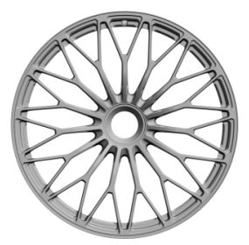

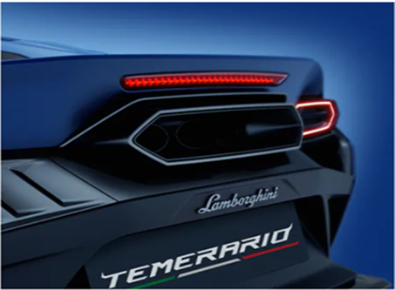
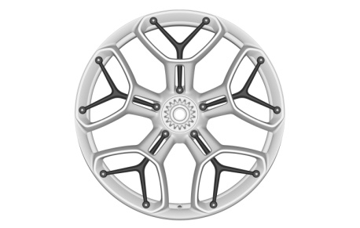
The Repair Clause
Impact on Automotive Industry
  In the automotive industry, the clause directly affects visible components such as rims, mirrors, and headlights. By restricting OEM exclusivity, it opens the market to third‑party manufacturers, fostering innovation and price competition while balancing intellectual property rights with consumer interests.
Product Liability
  On top of the correct application of the repair clause, also product liability becomes relevant. New regulation extends liability beyond original manufacturers to economic operators modifying products. In some cases it could be difficult to detect a not original parts and in case of accident OEMs could be involved in lawsuits.
Field Monitoring
  Lamborghini performs field monitoring to assess after market parts and possible impact on our vehicles.
  Other tools could be available?

Slide 4
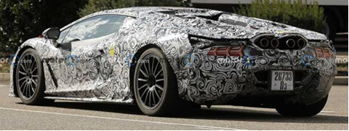
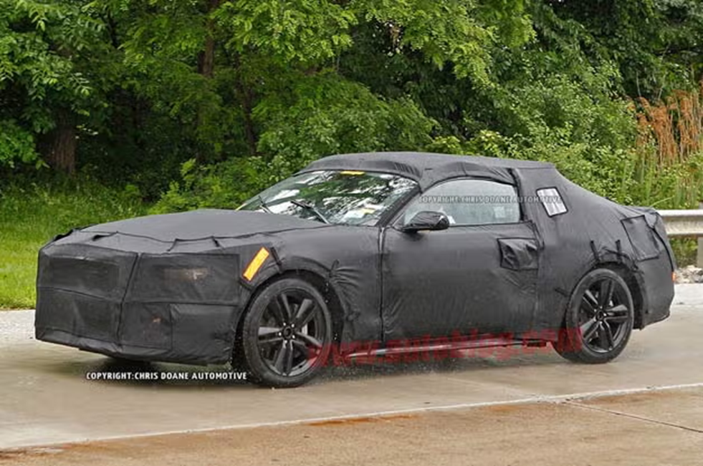
Deferred Publication
Strategic Deferral Tool
  Deferring publication is a strategic instrument that allows automotive OEMs to safeguard the novelty of their designs while continuing development and testing. By postponing disclosure, companies can refine prototypes and conduct road test – with appropriate camouflage - without compromising the novelty of their creations.
  Legal Protection Against Premature Disclosure
  This mechanism provides a protection during visible testing phases, ensuring that new designs are not prematurely exposed to competitors or the public. In case of need, the design could be disclosed safeguarding the protection (where possible).
  Secrecy Management Importance
  The effectiveness of deferred publication relies on rigorous secrecy management. Legal, technical, and organizational measures must align to maintain confidentiality – from controlled access to prototypes to contractual obligations and internal compliance protocols and proper camouflage.

Slide 5

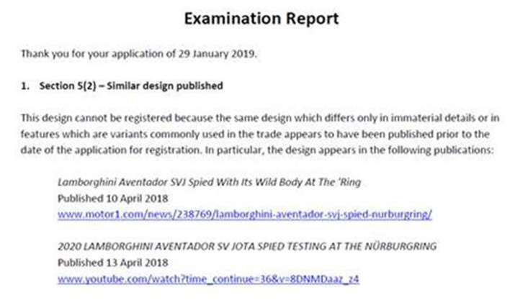
Leakage Risk – NEW ZEALAND CASE
Sources of Leakage
  Information leakage occurs through unofficial channels – social media posts, spontaneous test sightings, and online journalism – and through official communications that inadvertently reveal design details. These leaks can compromise confidentiality long before a product’s official unveiling, eroding the strategic advantage of controlled disclosure.
Legal Consequences
  When confidential design information becomes public, the loss of novelty can invalidate design rights and weaken enforcement capabilities and obliges the OEM to publish the design. The legal impact is immediate and often irreversible: New Zealand Office refused the registration due to leakage images and lack of novelty.
  OEMs refrain from publication prior to the official unveil facing the risks of lack of protection especially in countries where the grace period is not present.

Slide 6
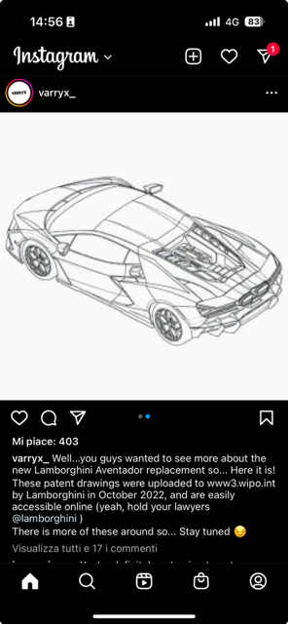
The North Macedonia Case
Case
  The North Macedonia office published the design of the vehicles notwithstanding the request of deferral. WIPO immediately recognized the mistake and removed the images that nonetheless spread on the web.
Risk Beyond Control
  Disclosure of deferred designs showed that even compliant right holders face risks outside their control.
Challenges to Trust and Coordination
  The case questions institutional reliability, emphasizing the need for trust and better coordination and a prompt decision making process in the OEMs organization that, in general, are against the publication of design prior to official unveil.

Slide 7

THANK YOU

